Slide 1
EDUCATIONAL CERTIFICATES DATA EXCHANGE STANDARD
Presented by
Umair Anwar
Notes:
In the name of God, the most merciful the most beneficent.
Hello everyone,
This is Umair presenting “Educational Certificates Data Exchange”.

Slide 2
Project supervisor
DR SHARIFULLAH KHAN
Committee Members
DR SARAH S KHAN
DR HAMID MUKHTAR
MR MUJTABA HAIDER
Notes:
I thank you all for attending.
<Unfortunately Mr. xyz is not joining us.>

Slide 3
Agenda
Introduction
Need for this research
Literature Review
Proposed Solution
  Proposed Architecture
  Proposed Data Format
  Business Process
  Semi-Automated SDRES XML to DB Mapping Tool
  Central Portal for these Web Services
Notes:
I will discuss these agenda items;
First we will have an introduction and we will see why we need this research.
We will go through the Literature Review in this particular area and
Finally, we will look at our proposed solution. [in a bit detail]

Slide 4
Introduction and Need
Student certificate record is exchanged manually between educational institutes
Institutes need to verify this record
These records are not accessible to other institutes
Facilitate both parties to get benefit from technology
  Responsibility is shifted to the students
  Unable to automate any process that involves inter-exchange of records.
Notes:
Okay, lets begin with the Introduction.
Student certificate record is exchanged manually between educational institutes.
There are quite a few issues with this approach. It is slow and not workable very often.
For example;
This record is not verified every time.
Institutes need to verify this record but they are not able to verify it since record of one institute is not accessible to other institutes.
Well, this responsibility is shifted to the students themselves.
For example;
For admission, each student has make sure that his certificates are attested by a gazetted officer and by educational authorities in some cases.
Secondly, we are not able to automate anything between these institutes.
For example; admission process, migration and mobility of student.

Slide 5
Problem Statement
Student certificate record exchange needs to be standardized in a way that institutes do not lose ownership of these records.
Notes:
If we look at these records.
Even though these are issued by different institutes but still document types and their content is quite similar and we can standardize these.
Secondly, every recognized institute is autonomous in issuing a certificate or degree and want to be owner of its own record.
There are secrecy departments where one institute keeps its record.

Slide 6
Objectives of this research
The thesis proposes a prototype infrastructure that will enable these institutes to inter-exchange student degree record digitally.
Infrastructure represents
  Data Format
  Architecture
Notes:
To address the standardization and ownership problems
Our solution solve these problems
We propose a prototype infrastructure that will enable these institutes to inter-exchange student degree record digitally.
Infrastructure means
Data Format addresses the standardization problem
Architecture addresses the ownership problem

Slide 7
Literature Review
Notes:
Lets look into our the existing research and what has been done in this area.

Slide 8
Existing Student Data Exchange Standards
Pouyioutas, P.; Gjermundrod, H.; Dionysiou, I.; Michael, M., "MAPQFTOOL: A software tool to support national qualifications frameworks," Information Society (i-Society), 2011 International Conference on , vol., no., pp.198,203, 27-29 June 2011
Karampiperis, P.; Sampson, D.; Fytros, D., "Lifelong Competence Development: Towards a Common Metadata Model for Competencies Description - The Case Study of Europass Language Passport," Advanced Learning Technologies, 2006. Sixth International Conference on , vol., no., pp.677,681, 5-7 July 2006
Rafał Nagrodzki, The Mobility Project (December 2009)
Karol Kański Integration of services in the Mobility Project (June 2011)
Notes:
Lets start by looking into the existing student exchange standards.
Primary references

Slide 9
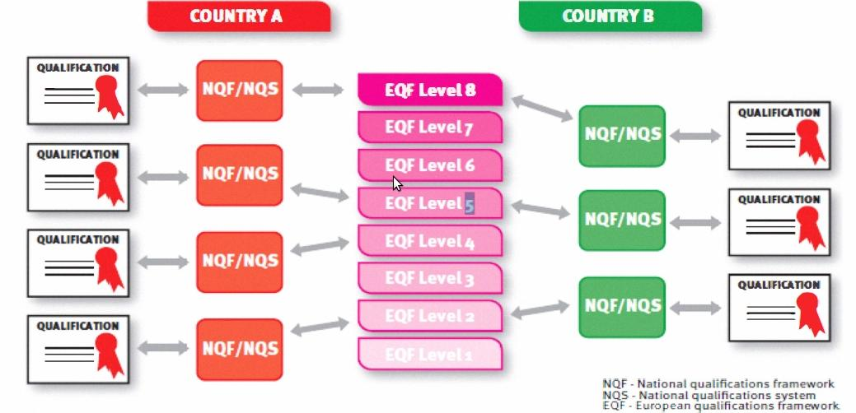
European Qualifications Framework (EQF)[1]
Common Reference Framework
Helps participating countries to compare national qualifications
From 2012, qualifications carry a reference to EQF level.
Notes:
European Qualifications Framework.
It is a common reference framework to solve equivalency problem of qualifications across European countries.
For example, we have two countries A and B
A has for qualifications to reach level while B has 3 qualifications to reach same level.
This framework solves this equivalency problem.
It is quite amazing that from 2012, qualifications carry a reference to EQF level.
Now when apply in some other country, you don’t have to worry about equivalency. [he needs not to worry about the equilency]

Slide 10
Europass
Collection of five documents
Curriculum Vitae, Language Passport [2], The Mobility, The Diploma Supplement, and Certificate Supplement
<DocumentInfo>
<DocumentType>ECV</DocumentType>
<CreationDate>2012-03-01</CreationDate>
<LastUpdateDate>2012-03-01</LastUpdateDate>
<XSDVersion>V3.0</XSDVersion>
<Generator>XML Editor</Generator>
<Comment>Example CV XML according to XSD v3.0</Comment>
</DocumentInfo>
Notes:
Europass
It is a collection of five documents.
Curriculum Vitae, Language Passport, The Mobility, The Diploma Supplement, and Certificate Supplement
It is also an effort to standardize documents. The standard is quite simple. Here is an example in XML and its vocabulary is quite self-explainatory.

Slide 11
Schema for Academia (SCHAC)
Vocabulary related to Degrees and Courses
Written in LDAP, not XML
For example;
  schacMotherTonge uses ISO-639 language codes
  schacGender uses ISO-5218 gender codes
Notes:
Schema for Academia (SCHAC)
It has vocabulary related to degrees and courses.
It is written in LDAP and not in XML
Its beauty is that it compliance with ISO standards.
- schacMotherTonge uses ISO-639 language codes
- schacGender uses ISO-5218 gender codes

Slide 12
European Learners Mobility
The Mobility Project [3] by Rafal Nagrodzki
Aims to exchange student data for student mobility
Proposes a data standard and architecture
XML Based standard using SOAP
Designed in context of Europe under EHEA
The REST Mobility by Karol Kanski [4]
Restful implementation of standard proposed by Rafal Nagrodzki
Notes:
European Learners Mobility
These are two research thesis (this research work aims to ease the mobility of students fr---- another. The later is the extension of above mentioned work which also provides…)that aim to ease mobility of students from one university to the other.
It using an XML based standard for exchanging records.

Slide 13
Proposed System
- Architecture
- Standard Format
Notes:
Lets look into our proposed system.
Our proposed system is an Infrastructure that consists of Architecture and our proposed standard.
The architecture deals with Ownership Problem
And the proposed format addresses the standardization problem

Slide 14
Proposed Architecture
Notes:
Let me present you the proposed Architecture

Slide 15
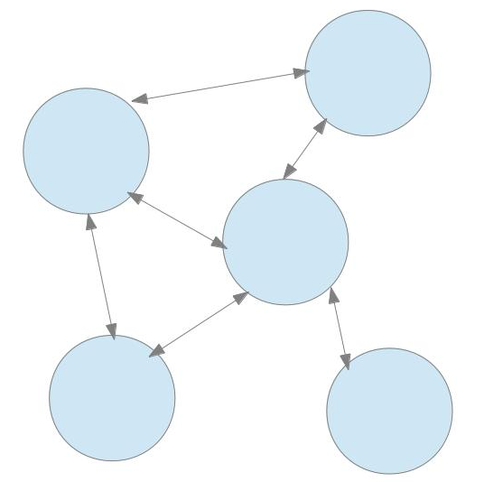
Proposed Architecture (1/2)
distributed architecture
Benefits;
  Avoidance from single point of failure
  Fewer loads
  Each node has control over its own data, thus building trust in system
Notes:
We propose a distributed architecture where each university represented by blue node that has its own data.
When another university need to verify a record, it ask that university.
It has some benefits like
- there is no single point of failure
- load is less, and particularly
- Each node has control over its own data. This building trust in system.
However for this system to work;
- each node must know the address of other node.
- and these nodes must be able to understand each other.
To know other nodes it must maintain an address list. This address list can be maintained locally or an authority can maintain it.
Each approach has its benefits.
[sync issues]

Slide 16
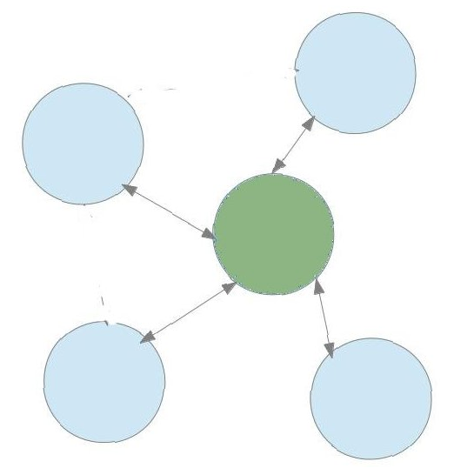
Proposed Architecture (1/2)
distributed architecture
Benefits;
  Avoidance from single point of failure
  Fewer loads
  Each node has control over its own data, thus building trust in system
Notes:
We recommend to store this address list on a central server.
Although we are compromising “Avoidance from single point of failure”, but we are gaining control.
Now we know that each node has a same address list and it is easy to have a single valid authentic list maintained by an authentic authority.

Slide 17
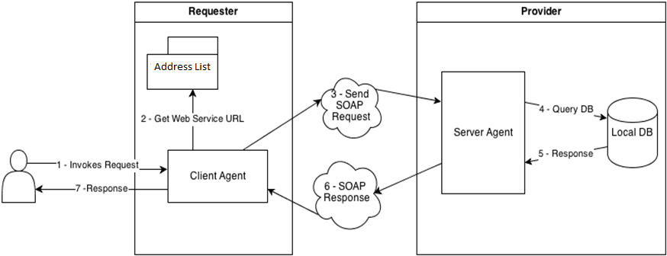
Proposed Architecture (2/2)
Notes:
[change diagram and remove registry]
The node which is requesting is requester and the node which will serve is the provider.
The requester checks address from the address list and requests the provider in our proposed soap format.
The provider queries its database and serves response in our proposed soap format.

Slide 18
Important Considerations?
Why SOAP?
  SOAP web service uses well established standards HTTP or XML and provide abstraction from network details.
  XML-RPC lacks support for developer defined data types.
  REST is set of principles and not impose to be compliant with a clearly defined specification.
Notes:
Why we used Soap?
This vocabulary or our proposed standard may also used in REST.

Slide 19
Proposed Data Format
XML based
Rafal Nagrodzki fulfills some vocabulary requirements, we will reuse these terms.
  Not have vocabulary for annual based courses
  Only have vocabulary related to semester based system
Reusing the ideas from SCHAC as it uses ISO norms where possible.
  For example, using ISO country codes
Notes:
Lets look at our proposed data format now.
Our proposed Data Format is XML based and
We have re-used some vocabulary from The Mobility Project
Also, we have re-used the ideas from SHAC to use ISO norms where possible.

Slide 20
Business Process – Sequence Diagrams
Notes:
What our proposed system will do?
Here are some basic functionalities.

Slide 21
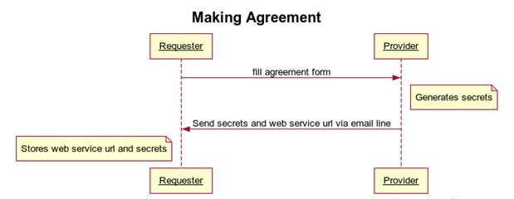
Business Process (1/4)
Notes:
Making Agreement
A node has to register in address-list by making an agreement.
[change diagram]

Slide 22
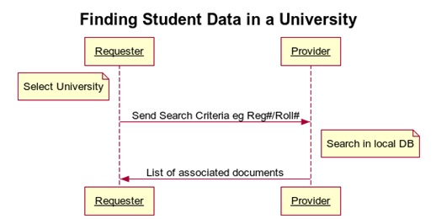
Business Process (2/4)

Slide 23
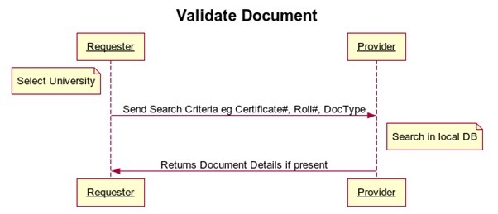
Business Process (3/4)

Slide 24
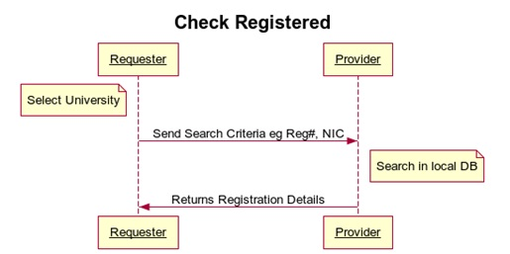
Business Process (4/4)

Slide 25
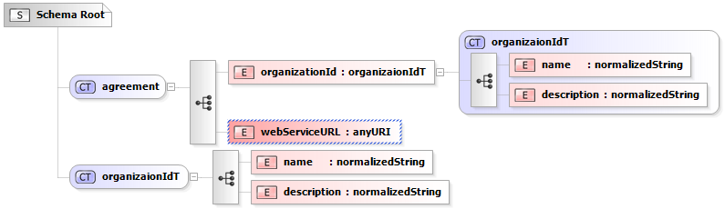
Vocabulary (1/3)
Notes:
This is vocabulary for an agreement.
An agreement consists of OrganizationId and WebService details.
OrganizationID has custom defined type organizationIdT.

Slide 26
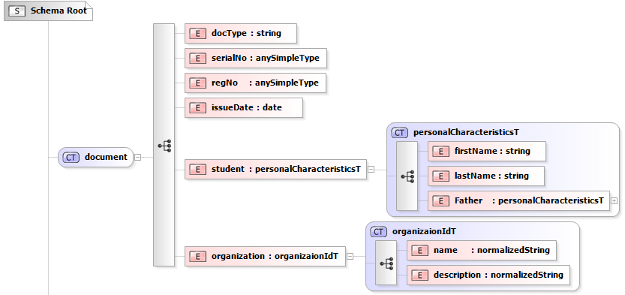
Vocabulary (2/3)
Notes:
This is vocabulary for Registration Card.
In this example, you see that a registration document has attributes, docType…..
Also, the student has custom defined data-type which is personalCharacteristicsT.

Slide 27
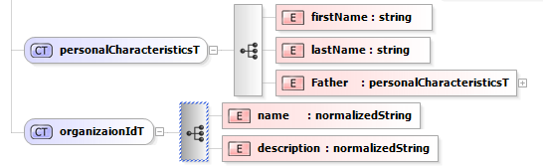
Vocabulary (3/3)
Notes:
These are the custom defined data-types we have used in previous slides.

Slide 28
Mapper
Semi-Automated SDRES XML to DB Mapping Tool

Slide 29
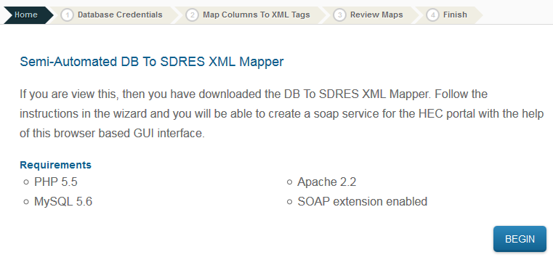
Mapper: download and unzip (1/4)

Slide 30
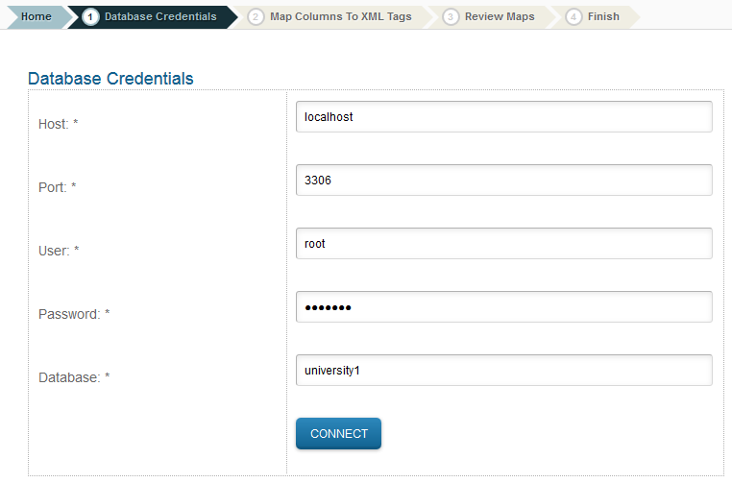
Mapper: provide db credentials (2/4)

Slide 31
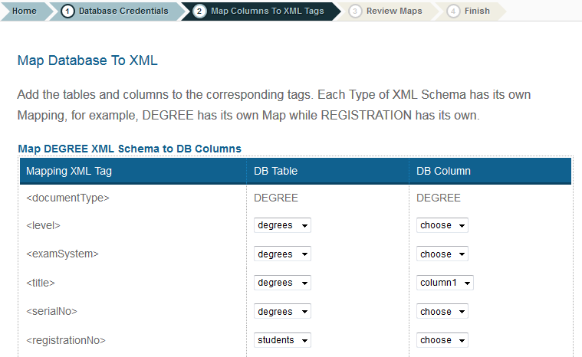
Mapper: create mappings (3/4)

Slide 32
Mapper: Web Service URL (4/4)
When mappings are successfully created a web service URL is returned.
This returned URL is sent to the Central authority Portal Admin to be added in the address list.
As it is added with correct credentials, it starts working with the portal since the service follows the same standard.

Slide 33
Prototype / Demo
Implementation of the Central Portal for these Web Services

Slide 34
References
Pouyioutas, P.; Gjermundrod, H.; Dionysiou, I.; Michael, M., "MAPQFTOOL: A software tool to support national qualifications frameworks," Information Society (i-Society), 2011 International Conference on , vol., no., pp.198,203, 27-29 June 2011
Karampiperis, P.; Sampson, D.; Fytros, D., "Lifelong Competence Development: Towards a Common Metadata Model for Competencies Description - The Case Study of Europass Language Passport," Advanced Learning Technologies, 2006. Sixth International Conference on , vol., no., pp.677,681, 5-7 July 2006
Rafał Nagrodzki, The Mobility Project (December 2009)
Karol Kański Integration of services in the Mobility Project (June 2011)

Slide 35


